Slide 1

ETS Engineering & Assoc. product development

Slide 2

special skills we offer at ETS Engineering
Incorporating Product development
Design, in House Tooling & Manufacturing
In House Equipment , vertically integrated
Iso 9001Certification
3d modeling/quick turn/engineering spec control dwgs
Sketch dwgs-3d modeling-engineering dwgs-machine layout

Slide 3

Machine List
-Haas VF3 Vertical machining center Fadal VMC 4020
X travel : 40“ X axis travel: 40”
Y axis travel: 20“ Y axis travel:20”
Z axis travel 25“ Z axis travel 25"
8100 RPM spindle 10000/15000 RPM spindle
HRT210 8" 4th axis rotary table
Thru spindle coolant ENGEL Victory 80/30
30 ton molding machine
-Haas VF1 Vertical machining center Vertical Molding capability
X axis travel: 20“ Powder Coating
Y axis travel: 20“ Plating
CDR 2 ton press
Z axis travel: 20“ PH5000R
10,000 RPM spindle punch and cut press
HRT160 6" 4th axis rotary table
WIPS probing system Charmilles Roboform 20
EDM Chamilles Technologies
-Yama Seiki GA2600 CNC lathe
X axis travel: 8“ FADAL VMC4020
Y axis travel: 13.77" 3 axis CNC- 10,000 rpm
4000 RPM, 15hp spindle
10" chuck Industrial Autoclave - Epoxy bonding
13" turning diameter
2.55" bar capacity

Slide 4
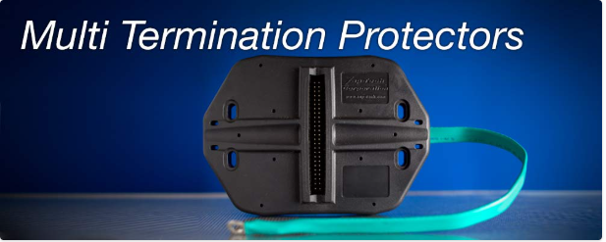
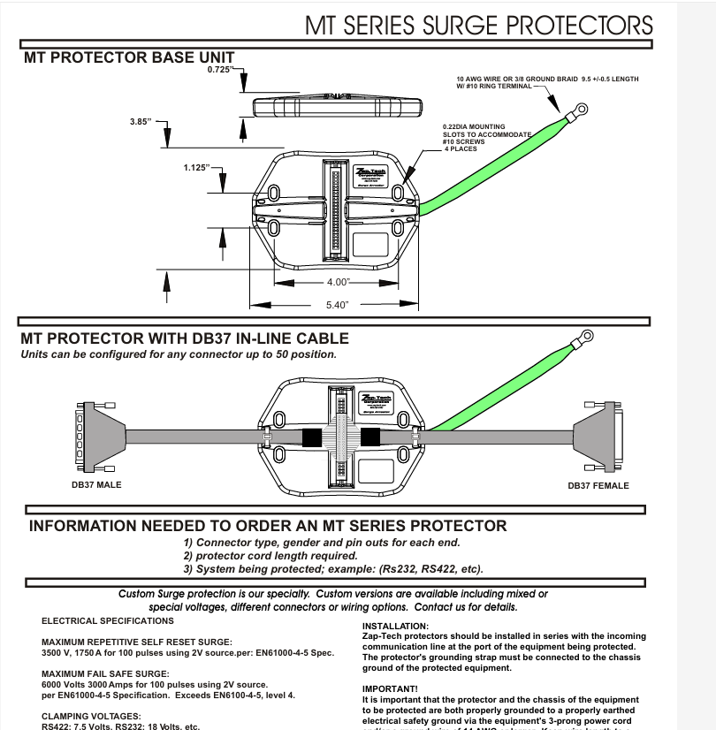
Specializing in over molded through hole & surface mount pc board components
Over Molded PC boards with or without cables have a two-stage molding process, Pre-Mold and Final Mold
Developed / Designed
Howard Holmes, lead process and design engineer, expertise in new product development

Slide 5

Contacts for engineering
Cameron English
cenglish@englishsales.com
Contact for RFQ and inquiries
Cameron English
480-384-0582
www.engtech@englishsales.com
Our technical development and manufacturing team
Design and Development
Cameron English– depth of experience in overmolded engineering and connector design-aerospace and industrial design
Custom backshells – custom overmold – custom connectors – complex assembiles
Precision Machining
Howard Holmes - CNC Machine design expertise- layout and design
Precision Machining , build for manufacturability, Process engineering
Eric Brannon
Eric Brannon - Precision Machining-
Process and Mfg expertise

